Slide 1
VPP for Leaders
Development, Validation, Implementation and Enhancement for a Voluntary Protection Programs Center of Excellence (VPP CX) Capability for the Department of Defense

Slide 2
Elements for VPP Success
Leadership Role
Accountability
Employee involvement and contract workers

Slide 3
Leadership Role

Slide 4
Leadership Keys to VPP Success
Promote safety as a core value in everyday work as compared to a priority
Establish a framework rather than a “to-do list”
Commit to continuous improvement
Extend safety and health (S&H) beyond the safety office.

Slide 5
Management Leadership
Provide visible leadership by:
Supporting an environment that allows for reasonable employee access to top site management
Setting examples of safe and healthful behavior
Monitoring progress and celebrating achievements
Reinforcing change to an employee-centric program
Engaging VPP mentors to help accelerate culture change
Eliminating barriers for stakeholder involvement.

Slide 6
Management Leadership
Demonstrate leadership by establishing solid communication throughout the organization in all aspects
Establish and communicate S&H goals, and objectives for meeting the goals
Incorporate S&H objectives into performance expectations.

Slide 7
Accountability

Slide 8
Rewards and Recognition
Accountability drives culture
Successful leaders hold managers and employees accountable
Establish performance expectations by:
Defining critical behaviors or traits
Including objectives that are:
Specific to the individual’s role
Support to organization’s S&H goals
Measurable and achievable.
Distinguish acceptable from exceptional performance.

Slide 9
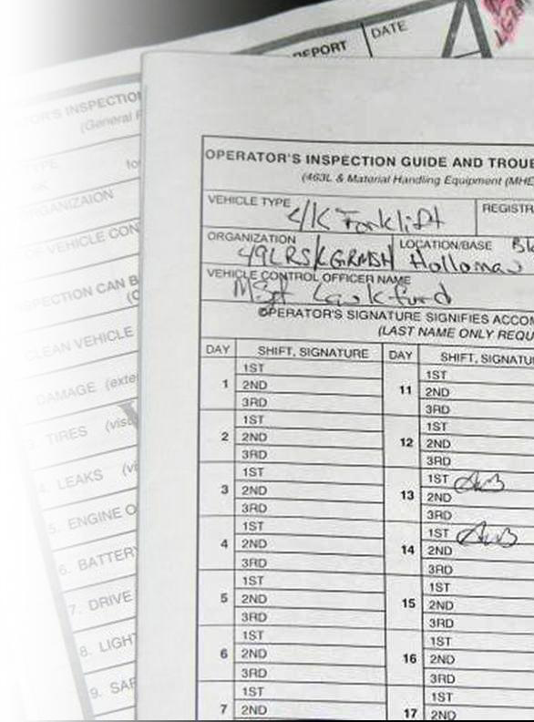
Disciplinary System
VPP requires that a disciplinary system be
Established
Communicated
Equitably enforced
Provide a policy statement on safety
Requirement to address on annual performance evaluations

Slide 10
Employee Involvement and Contract Workers

Slide 11
Support Stakeholder Involvement

Slide 12
Leaders Drive Employee Involvement
Provide visible support to employees
Site culture must enable and encourage effective employee involvement in at least three meaningful ways
Involvement goes beyond the individual’s right to notify supervisors of hazardous conditions and practices, and to have these issues addressed.

Slide 13
Contract Workers
VPP site contractor programs must include a documented oversight and management system that ensures the contractor’s site employees are provided effective protection
VPP sites are expected to encourage contractors to develop effective S&H program management systems.

Slide 14
Contract Workers
Monitor contractor adherence to worksite S&H rules and procedures
Establish provisions for removing contractor employees from site for violations.

Slide 15
Management Leadership
Establish S&H policy, goals, & objectives
Ensure top management leadership is actively involved in S&H
Hold all personnel responsible & accountable for their S&H performance
Communicate safety and health requirements effectively
Ensure S&H is integrated into the everyday process
Ensure adequate recourses are available to implement an effective S&H program.

Slide 16
Questions??

